Slide 1
ML – Stack Overflow 2023
ReDi School / Lena & Lubaba

Slide 2
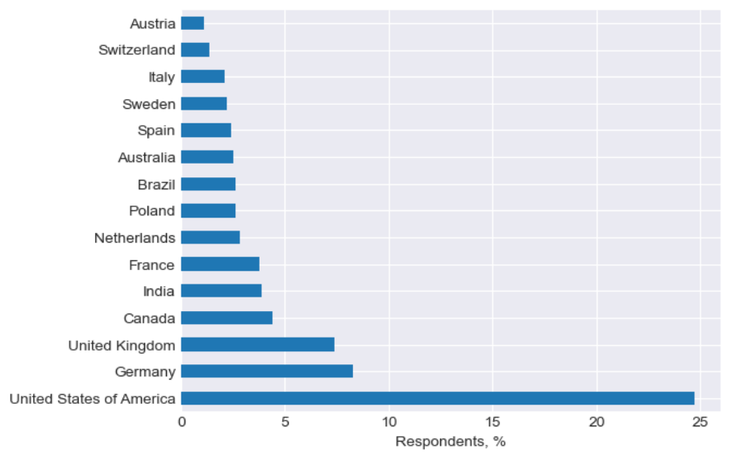
2023 developer survey
over 90,000 respondents all over the world
25% of respondents are from USA
No gender data
Contains age, education level, employment type and job positions as well as preferred programming languages and years of professional coding
46% of respondents specify their salary
82% of respondents have Bachelor’s degree or higher

Slide 3
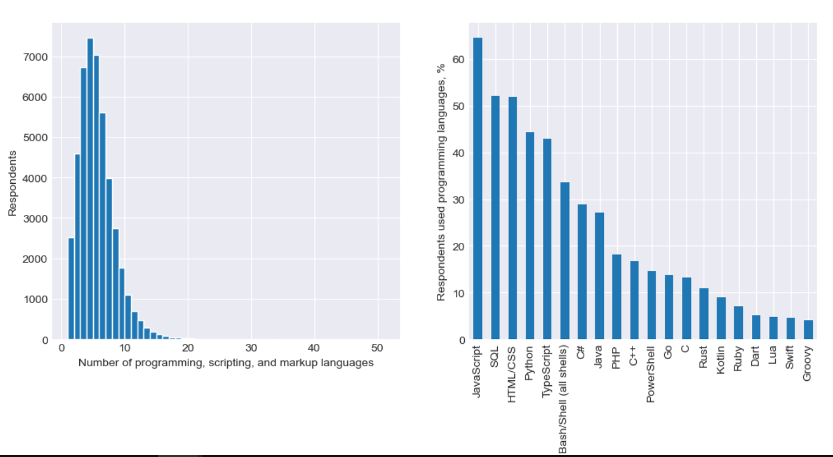
Programming languages used extensively in development work

Slide 4
Issues with data
High-dimensional data
High cardinality features (variables with too many labels) tend to dominate over those with only a few labels, particularly in tree based algorithms. A big number of labels within a variable leads to over-fit. Some of the labels may only be present in the training data set, but not in the test set. Contrarily, new labels may appear in the test set that were not present in the training set, therefore leaving algorithm unable to perform a calculation over the new observation
Co-linearity among numerical variables
Bias in the data based on a number of available records per country
2023 annual incomes have a number of outliers
All mentioned above indicates that using linear regression or regression tree to predict the annual could contains issues or need to be carefully adjusted

Slide 5
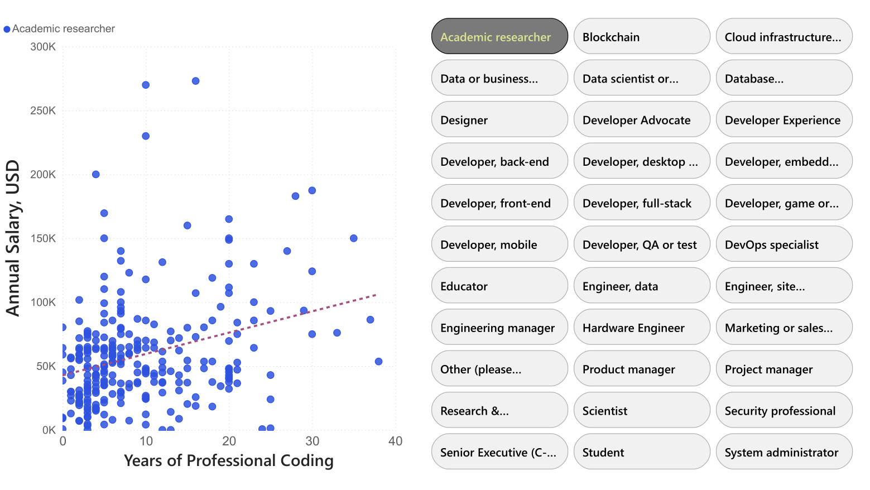
Salary vs professional coding experience

Slide 6
Choosing
Feature
Total number of unique DevType roles: 33
Model
Random Forest Regressor

Slide 7
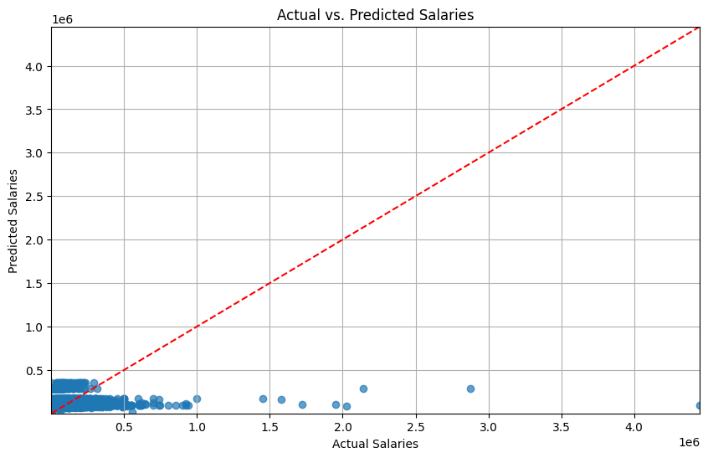
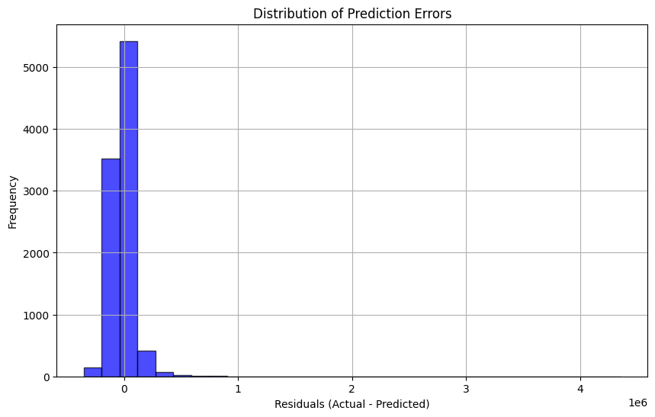
Random Forest Regressor
Mean Absolute Error: 60093.078065855785
Root Mean Squared Error: 106710.4030517729

Slide 8
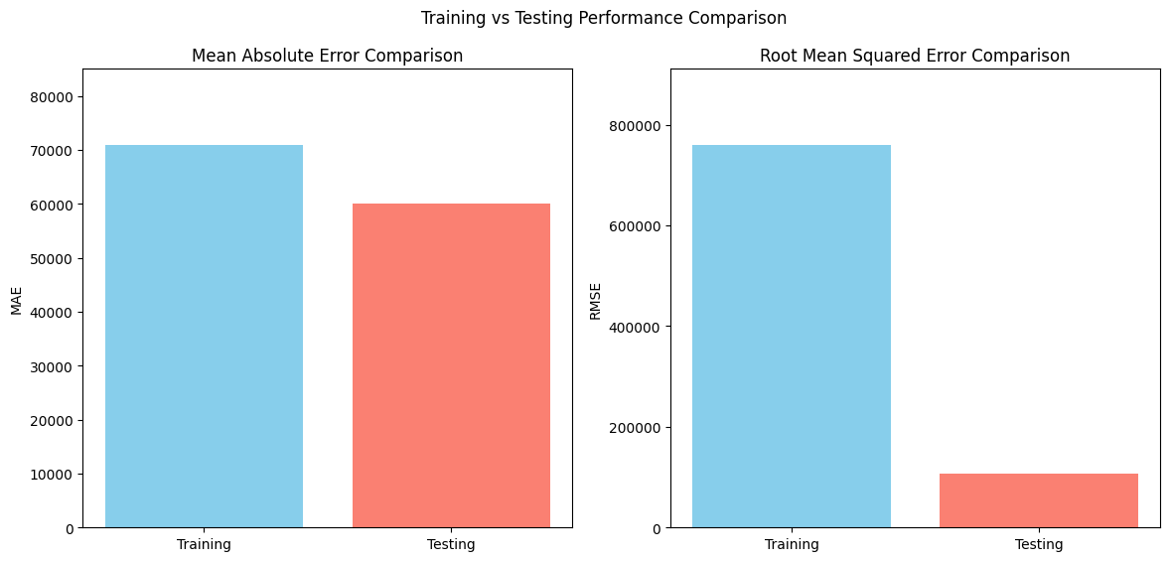
Training vs. Testing Performance
Training Set Performance:
Mean Absolute Error: 70859.096943387
Root Mean Squared Error: 759256.6622214675
Testing Set Performance:
Mean Absolute Error: 60093.078065855785
Root Mean Squared Error: 106710.4030517729
Notes:
Interpreting the Training and Testing Results:
Training Set Performance:
MAE: 70,859
RMSE: 759,256
The training MAE and RMSE values are relatively high, especially RMSE, which may indicate some noise or complexity in the data that the model is trying to capture. However, it also suggests that the model fits the training data well within a reasonable margin.
Testing Set Performance:
MAE: 60,093
RMSE: 106,710
These results show lower errors on the testing set compared to the training set, which is a positive outcome. A lower MAE and RMSE in the testing set compared to the training set indicates that the model generalizes well and does not overfit the training data.
Summary:
Since the testing performance is better than the training performance, it suggests that the model is not overfitting, which is often a goal when using Random Forest for prediction tasks. The slight decrease in errors on the testing set suggests that the model is likely learning significant patterns rather than noise.

